Slide 1
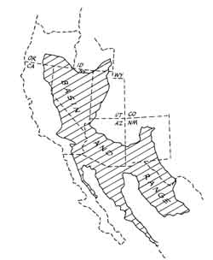
Rio Grande Rift
Guadalupe Mountains
Notes:
Once again we find ourselves looking at a park on the edge of the Basin and Range province – this time the far southeastern edge. Guadalupe Mountains National Park lies within a distinctively different portion of the Basin and Range known as the Rio Grande Rift.

Slide 2
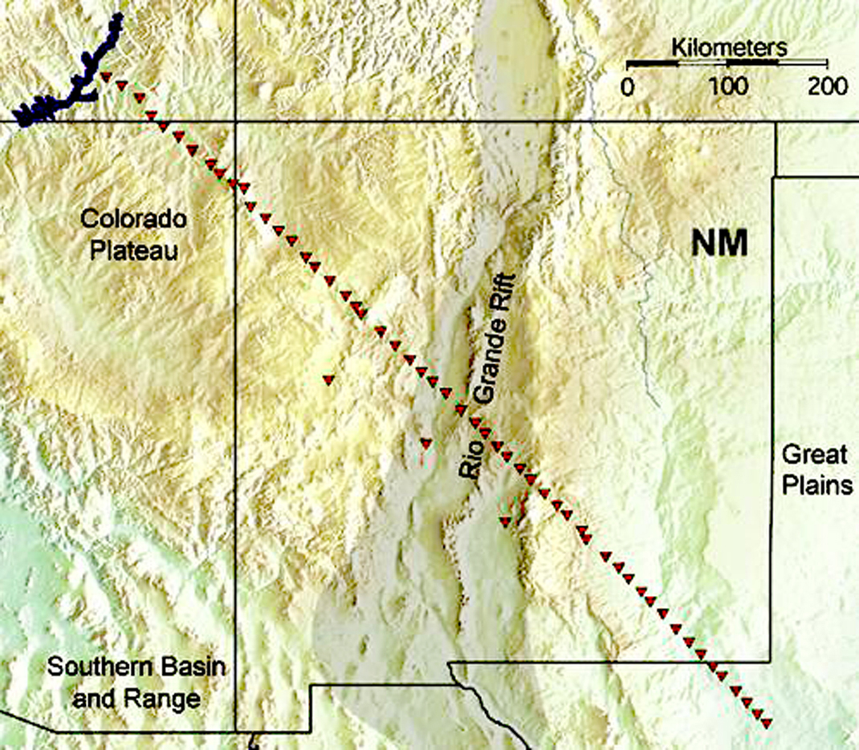
Notes:
Recent seismic studies across the Rio Grande Rift near Albuquerque reveal its characteristic structure…

Slide 3
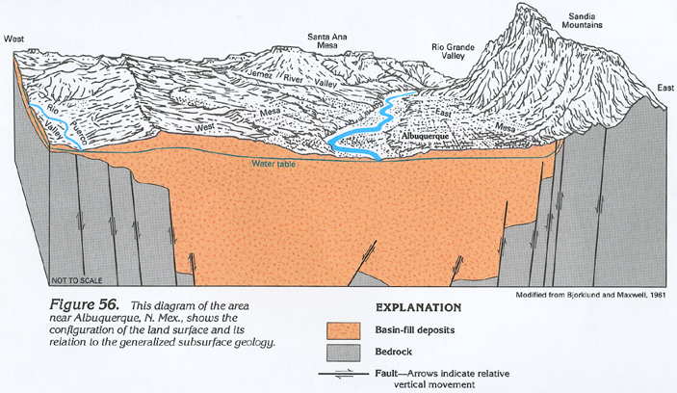
Rio Grande Rift near Albuquerque, N.M.
steep normal faults
Notes:
… which consists of closely spaced, steeply dipping normal faults. Unlike other parts of the Basin and Range, very little rotation on the fault blocks has occurred along the Rio Grande Rift, …

Slide 4
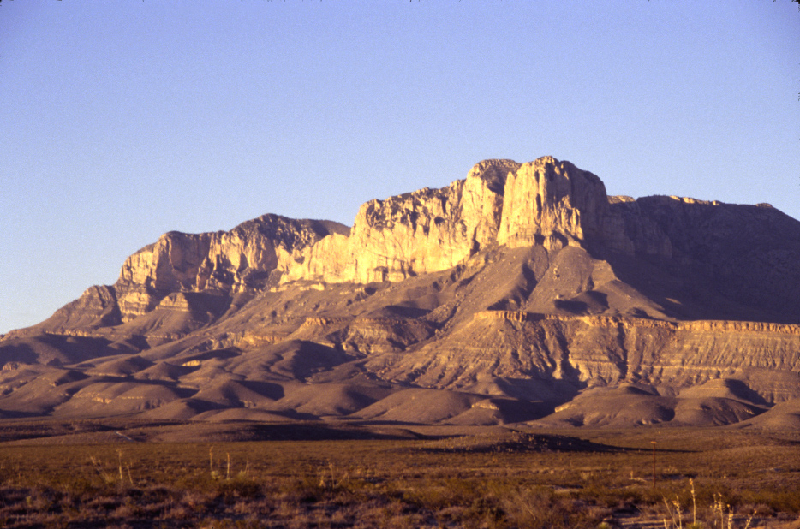
Normal faults cause gentle ENE dip
Notes:
… such that strata like these in the Guadalupe Mountains have only a gentle ENE dip caused by rift normal faults.

Slide 5
Rio Grande Rift near Albuquerque, N.M.
Sediment filled allochogen
Notes:
Because the faults are virtually inactive today, many geologists consider the Rio Grande rift to be an allochogen, which you of course remember is a failed rift. The rift opened almost 30 million yeas ago, but the degree of extension here never got anywhere close to that of the rest of the Basin and Range.

Slide 6
Domino theory rotation
Notes:
Perhaps that explains why the normal faults have not rotated to more gentle dips as is the case elsewhere in the Basin and Range.

Slide 7
20,000’
Notes:
At any rate, normal faulting along the rift produced well over 20,000 feet of vertical offset in many areas. Streams flowing into the rift were therefore given an enormous amount of gravitational potential energy by which they could erode the rift’s shoulders.

Slide 8
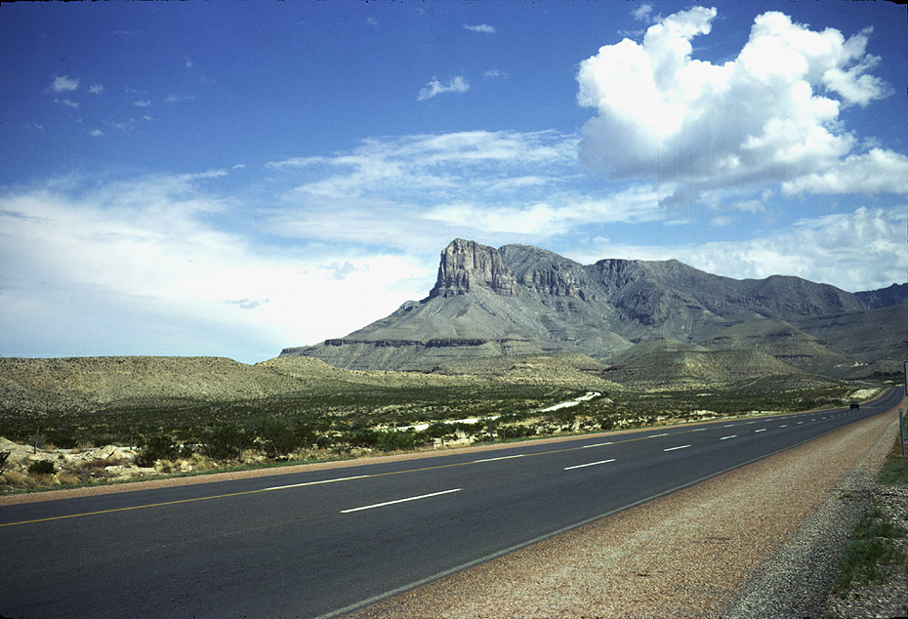
El Capitan
Notes:
Guadalupe National Park is situated on one of those eroded shoulders. Here, the erosion which accompanied the formation of the Rio Grande Rift exposed an amazingly well-preserved reef from the Permian period. The reef’s massive core outcrops majestically on the cliffs of El Capitan – the park’s signature landmark and type locality for the Capitan Reef,…

Slide 9
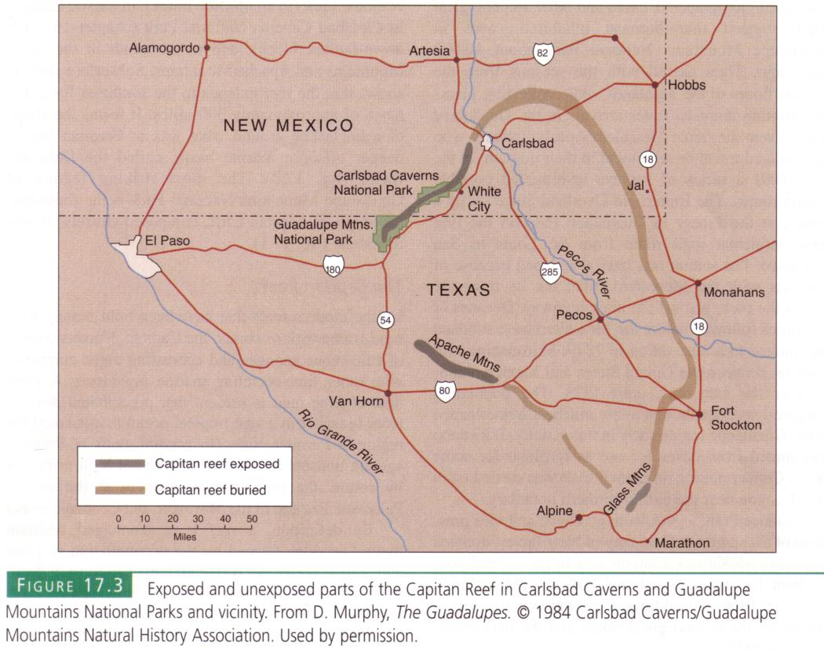
Notes:
… which is exposed in the Guadalupe, Apache and Glass Mountains. Extensive oil exploration in the region has revealed buried portions of the reef that complete a nearly continuous circuit around what during the Permian period was a deep ocean basin …

Slide 10
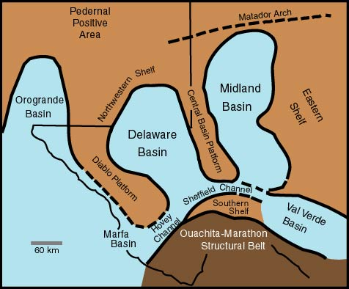
Guadalupe Mountains
Notes:
… known as the Delaware Basin. It and several other basins comprise what is collectively known as the Permian Basin.

Slide 11
subsidence
Notes:
Apparently these basins formed during the final stages of Pangaea’s formation. The collision of North and South America forced the southwestern margin of North America under South America, thereby causing subsidence.

Slide 12
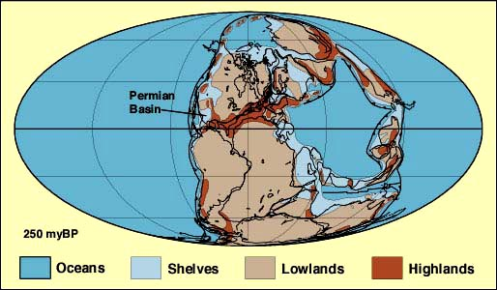
PERMIAN PALEOGEOGRAPHY
Notes:
Because these basins were near the equator during Late Permian time, the warm tropical sea water promoted reef growth …

Slide 13
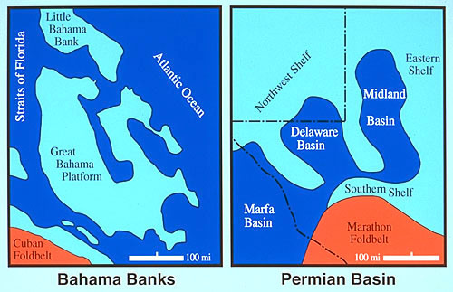
Notes:
… much in the same way that modern reefs form on the Bahaman Banks. These two diagrams are the same scale, so except for being next to deeper basins, the Bahamas Banks are pretty good modern analogues to the reefs of the Permian Basins. The Capitan Reef which surrounded the 600-meter deep Delaware Basin …

Slide 14
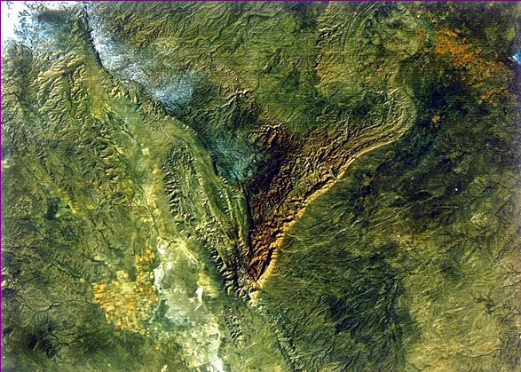
Rio Grande Rift
Guadalupe Mountains
Notes:
… is best exposed in the Guadalupe Mountains because that portion of the reef is closest to the Rio Grande Rift where maximum erosion occurs.

Slide 15
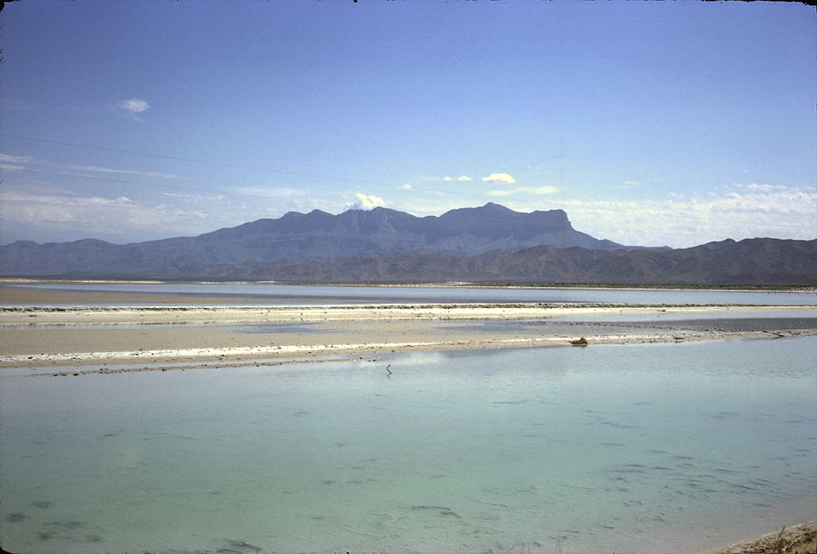
Guadalupe Mts. from Salt Flat Graben
1 mile
Notes:
The degree to which the reef has been exposed is dramatically illustrated from the low point at Salt Basin where about a mile of relief separates the basin from Guadalupe Peak. Mostly what was eroded here was a soluble gypsum unit which we will cover in greater detail later.

Slide 16
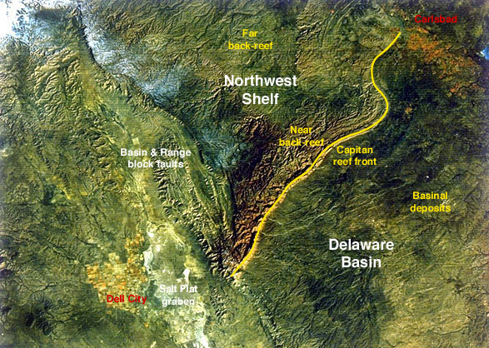
Notes:
The big story here is the complete set of ancient reef “facies” exposed in the Guadalupe Mountains.

Slide 17
FACIES
Rock mass characteristics that reflect depositional environment.
Notes:
In geology, facies refer to rock mass characteristics that reflect depositional environment.

Slide 18
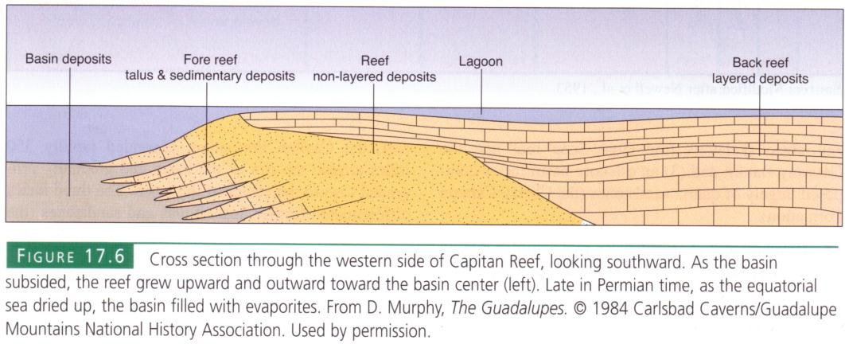
Notes:
Depositional environments in and around reefs vary from deep water basinal deposits, to mid-depth fore reef, to shallow water reef, lagoon and back reef deposits. In the Guadalupe Mountains each of these facies is represented by a different geological formation …

Slide 19
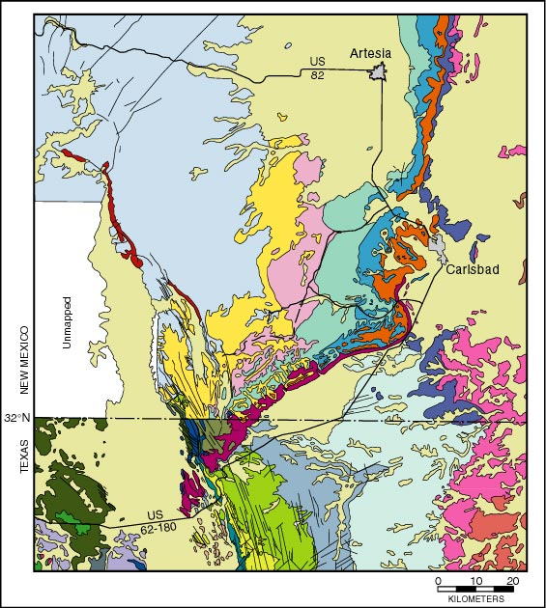
Notes:
… on the geological map of the area.

Slide 20
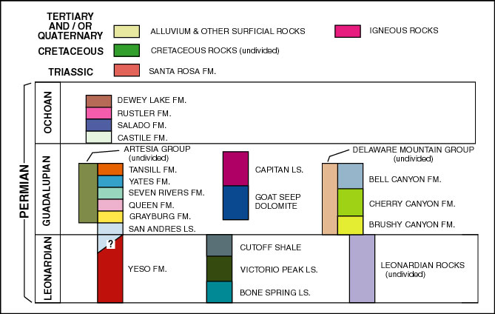
Notes:
Different facies are often depositing at the same time but in different environments. For example: The Capitan Limestone represents the reef front, but the Tansill and Bell Canyon formations where depositing at the same time in the back reef and deep basin respectively.

